Slide 1
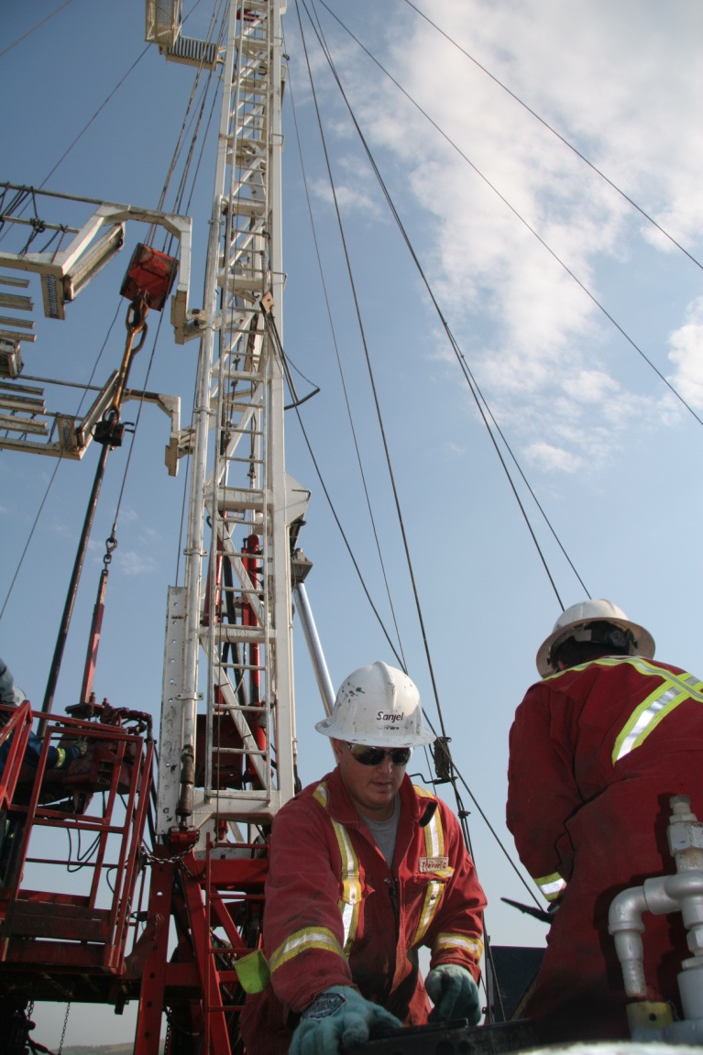
Sanjel 101 – Sanjel Overview Presented by Adam Wang
July 14, 2017

Slide 2
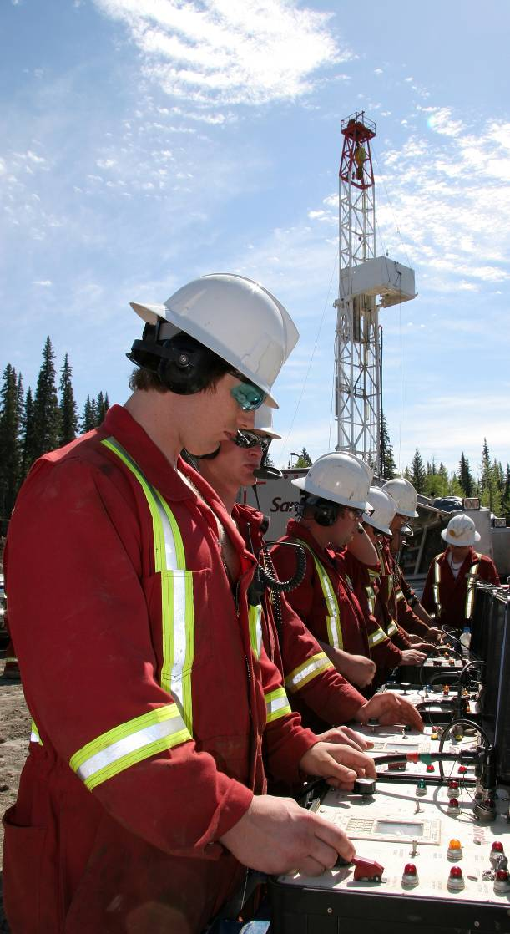
Corporate Overview
Specialized global energy service company
Privately-owned, Canadian-based
9 district offices in western Canada

Slide 3
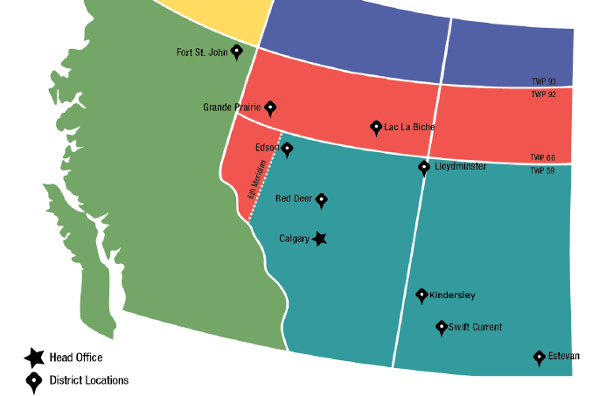
Sanjel Canada District Locations
* Global and Canadian Head Office

Slide 4
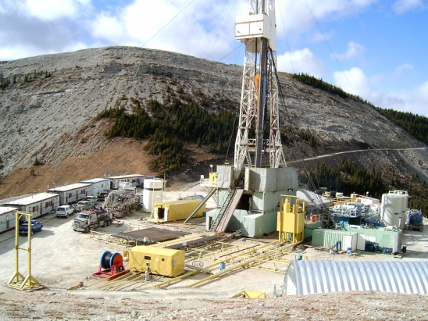
Service Lines
Specialized energy solutions in two service lines:
Acidizing
Cementing

Slide 5
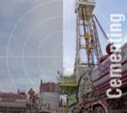
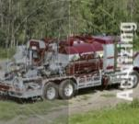
Sanjel Service Lines Overview
Cementing A decade of being the largest cementing services company in Canada requires proactive solutions and consistent performance. Established resources and technology to provide services on 350+ rigs globally.
Acidizing Sanjel offers an extensive array of acidizing services along with proprietary blends and additives designed to help our customers realize the full potential of their wells productivity.
Notes:
5

Slide 6
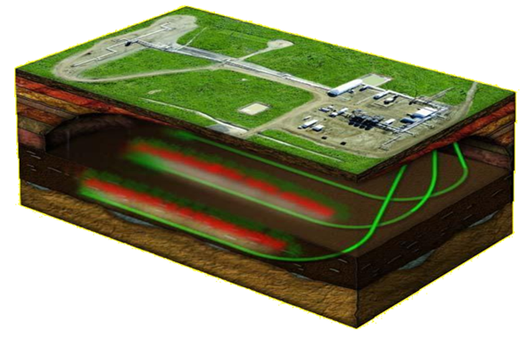
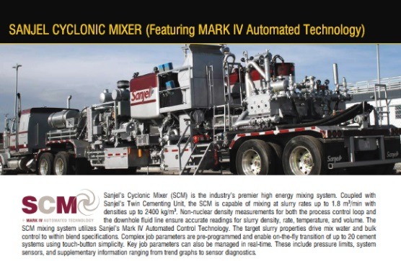
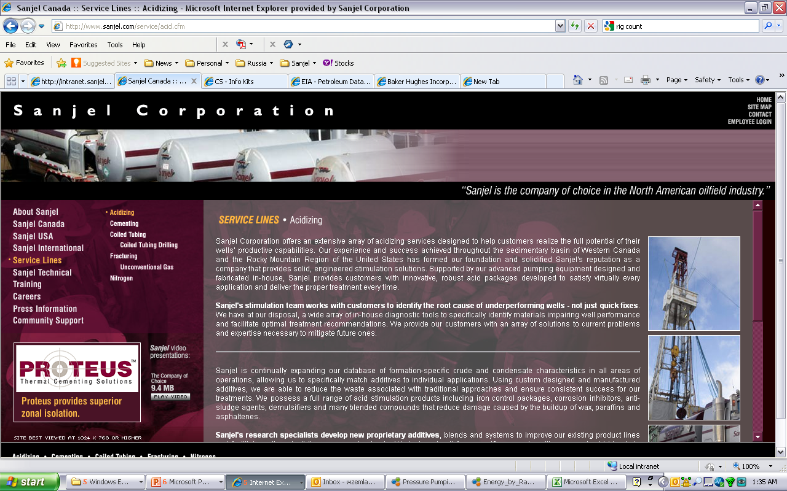
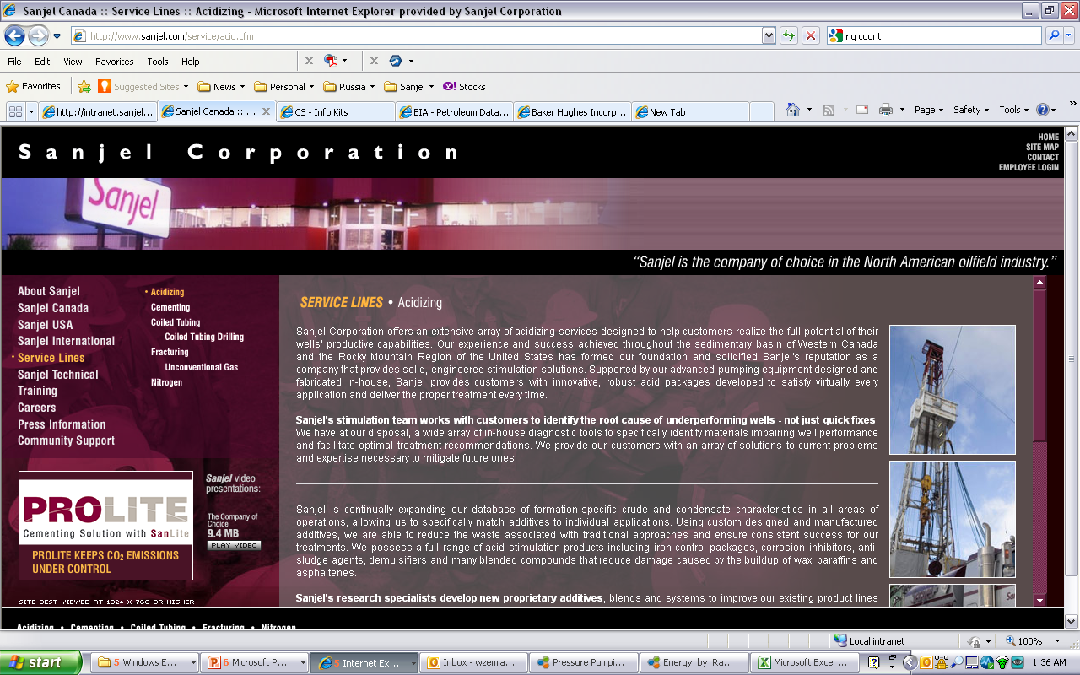
Cementing Technology

Slide 7
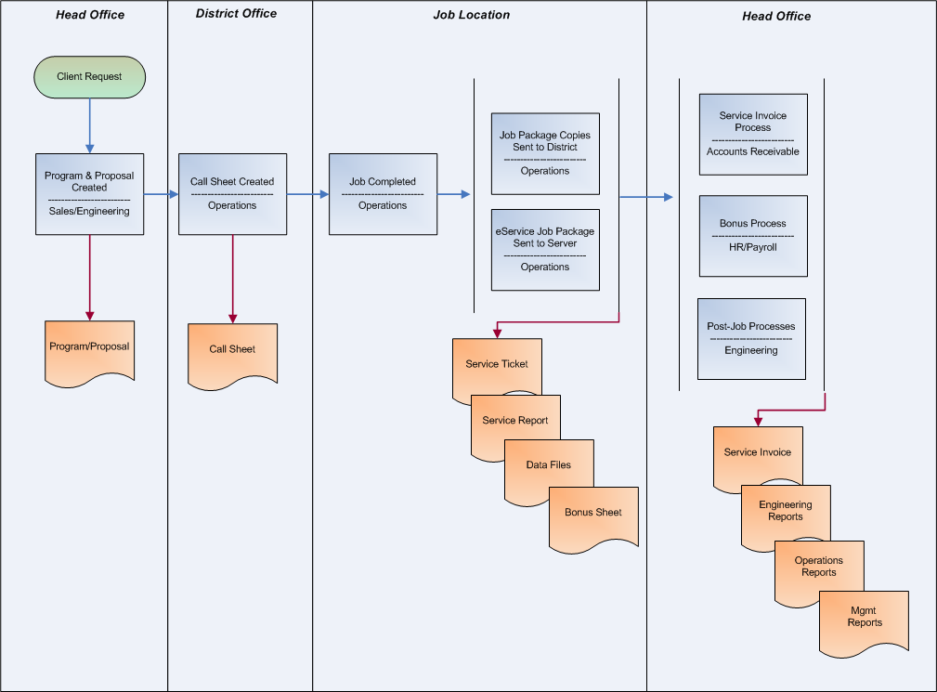
High Level Job Life Cycle
Acidizing  Cementing  Coiled Tubing  Fracturing  Nitrogen | Canada  USA  International

Slide 8
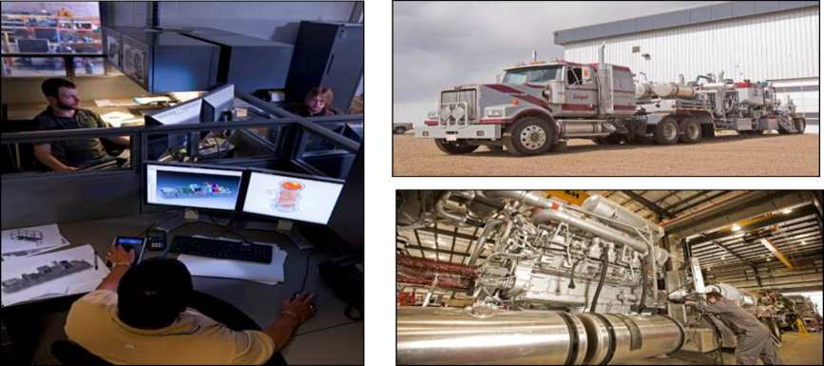
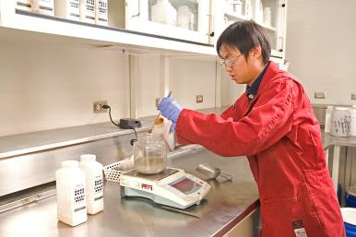
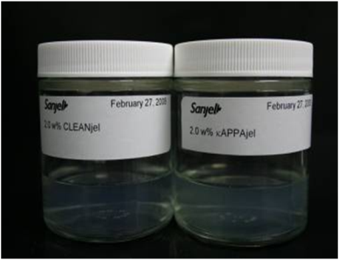
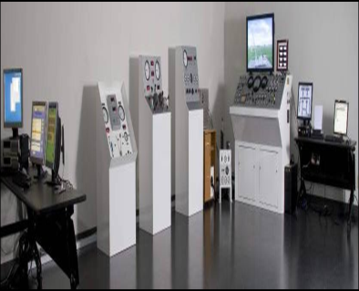
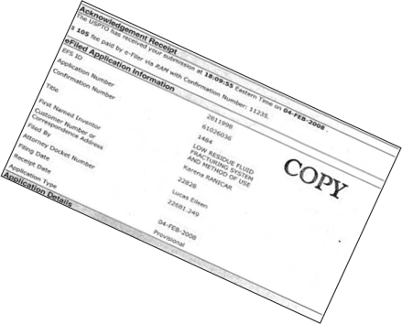
Operations Support Infrastructure
Equipment Engineering
Technology Center
World Class Laboratories
Training Centers
Sanjel equipment designs
Lower total cost of ownership
Extended Asset Life
Fabrication & Manufacturing
Develops technology to provide global oilfield chemical solutions
24/7 ongoing technical support for field operations
Quality assurance
Technical training
Cementing, Stimulation, Research and Environmental labs
Patented Technologies
Timely solutions
Training Simulators
Accelerate personnel growth
Enhance competencies

Slide 9
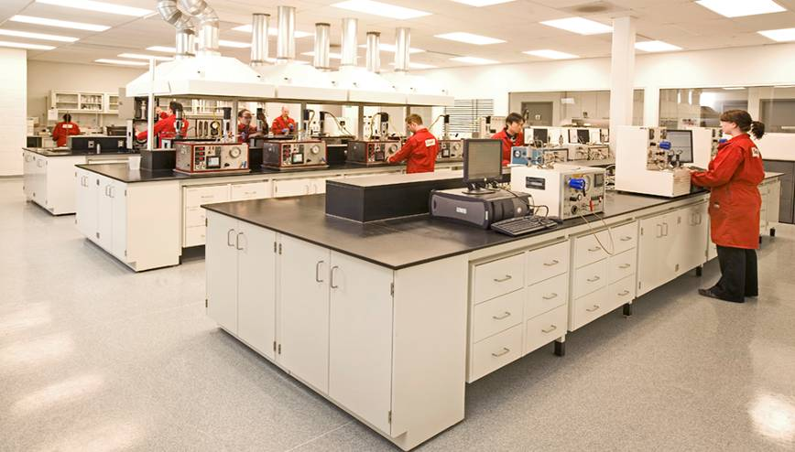
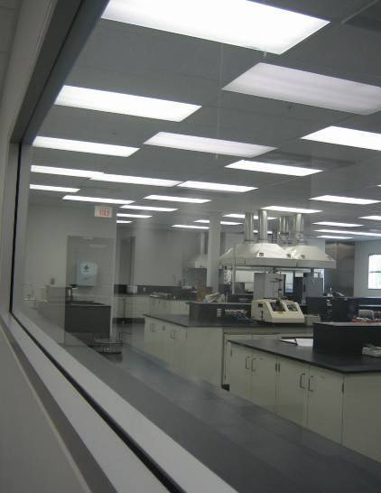
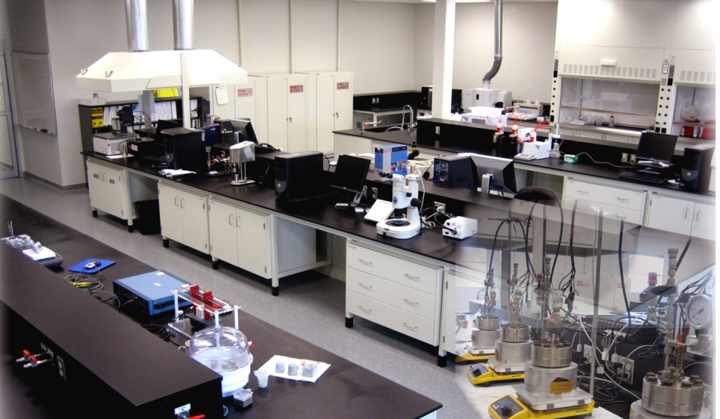
Three World-Class Laboratories
Cementing
R&D and Quality Control
Stimulation

